Slide 1
PORTAL PROCESS
VIDYANJALI
(Sikul K^ichhan)

Slide 2
SCHOOL REGISTRATION
vidyanjali.education.gov.in

Slide 3
Step 1
Register
Login
School
Individual/NGO/CSR

Slide 4
Step 2
Register
UDISE CODE
Captcha
Verify UDISE Code

Slide 5
Step 3
Register
School Registration
UDISE Code
Mobile
Email
Send OTP

Slide 6
RAISE REQUEST BY SCHOOL
vidyanjali.education.gov.in

Slide 7
Step 2
Login
School
Individual/NGO/CSR
Administration/State/District

Slide 8
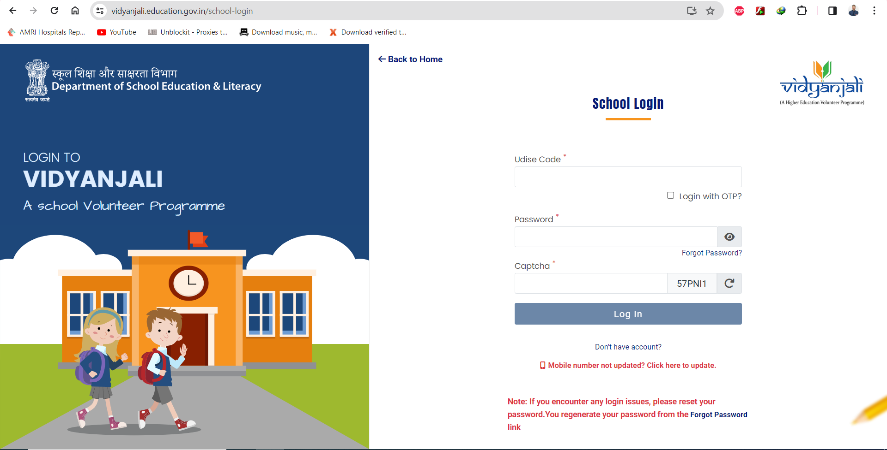
Step 3
School Login
Udise Code
Login with OTP
Password
Forgot Password
Captcha
Login

Slide 9
Step 4
School Name with UDISE Number
School
Dashboard
Activities
@Dashboard
@Activities
@Assets/Materials/ Equipment
@ Offline Contribution
@Become Mentor/Mentee
@Profile
@Reset Password
@Logout
0
1
0
Total Activities
0
Completed
Completed
Pending
0
Approved
0
Pending Approved
Assets/Materials
0
2
0
0
Completed
0
Approved
0
Pending Approved
Total Assets/ Materials
Completed
Pending

Slide 10
Step 5
School Name with UDISE Number
School
Assets/Material/Equipment
@Dashboard
@Activities
@Assets/Materials/ Equipment
@ Offline Contribution
@Become Mentor/Mentee
@Profile
@Reset Password
@Logout
Pending
Complete

Slide 11
Step 6
Add New Assets/Materials/Equipment Request
Assets/Material Category Assets/Material Name
Maintenance Required Quantity
Last date of receiving Expected Date
Details of Assets/Materials
Save & Publish

Slide 12
Step 7 (MENTOR/MENTEE)
@Dashboard
@Activities
@Assets/Materials/ Equipment
@ Offline Contribution
@Become Mentor/Mentee
@Profile
@Reset Password
@Logout
Mentor(Service Provider) Mentee(Service Receiver)

Slide 13
VOLUNTEER REGISTRATION
vidyanjali.education.gov.in

Slide 14
Step 2
Register
Login
School
Individual/NGO/CSR

Slide 15
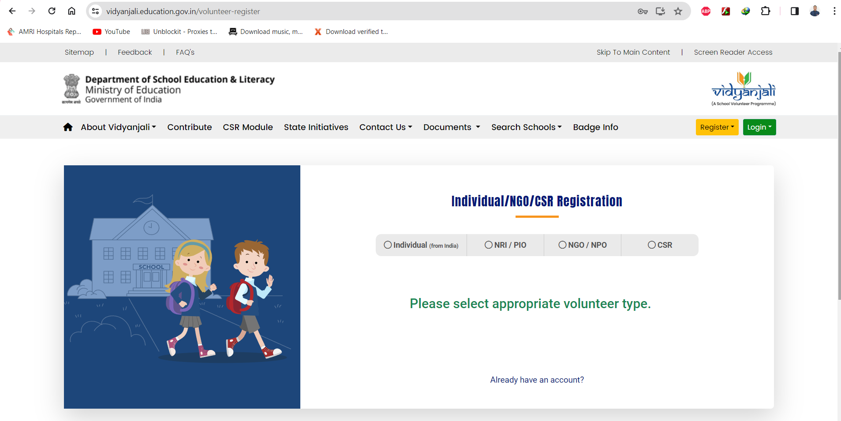
Step 3
Individual/NGO/CSR Registration
Individual NRI/PIO NGO/NPO CSR

Slide 16
Step 4
Individual/NGO/CSR Registration
Individual NRI/PIO NGO/NPO CSR
Name Email
Country Code Mobile Number
States/Uts District/Regions
Send OTP

Slide 17
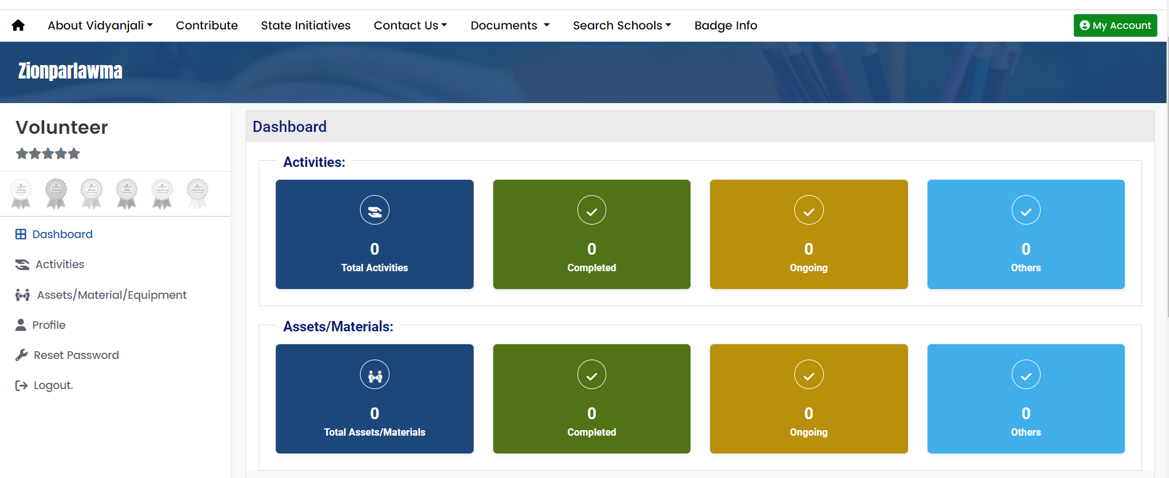
VOLUNTEER CONTRIBUTION (After Login to Volunteer Account)
Contribute
Volunteer Name
Dashboard
Activities
Assets/Material
Profile
Reset Password
Logout
Activities
0
0
0
0
Total Activities
Completed
Ongoing
Others
Assets/Materials
0
0
0
0
Total Assets
Completed
Ongoing
Others

Slide 18
Step 2
Contribute
Service/Activity Assets/Materials
Teaching Languages
Active Request 35

Slide 19
Step 3
Activity Name Gender Require Specification Application Date
School Name State Name District Name Activity Duration
View & Participate

Slide 20
Step 4
School Details
Name & Address
Activity Details
Activity Category
Activity Name
Tentative Activity Start Date
Application Last Date
Activity Duration
Details of the Activity
Volunteer Eligibility Criteria
Qualification
Gender
Participate

Slide 21
OFFLINE CONTRIBUTION (After Login to School User)
SCHOOL NAME & UDISE CODE
School
Activities
Assets/Materials
Project Requirement
Volunteer list
Preference Volunteers
OFFLINE CONTRIBUTION
Become Mentor/Mentee
Corporate School Parnership
Profile
Reset Password
Logout

Slide 22
OFFLINE CONTRIBUTION
Add Offline Assets/Materials/Equipment Request
Volunteer Details
Assets Details

Slide 23
TO GET DIGITAL CERTIFICATE
Login as Volunteer
Pending
Complete
Action
Activities
Assets/Material
θ
Go activities/Assets – Go Complete -- From Action rating the School

Slide 24
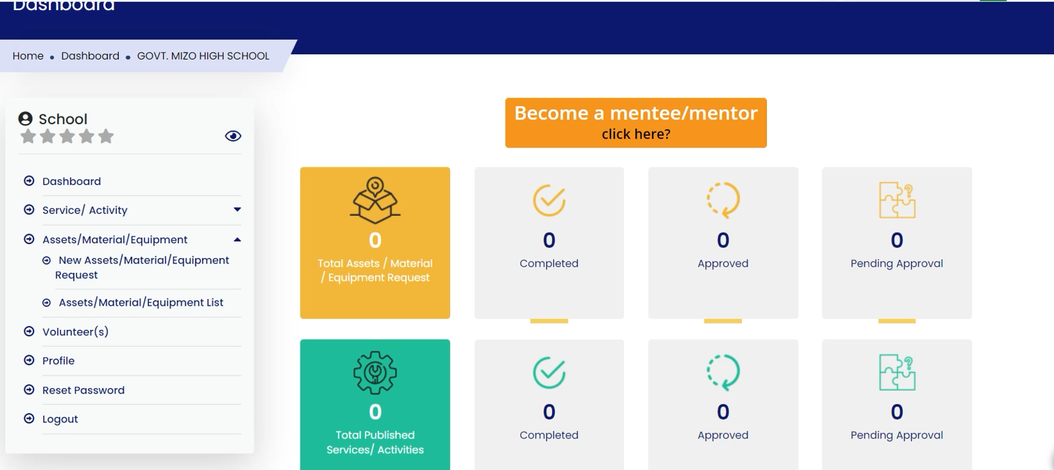
ACCEPTED CONTRIBUTION BY SCHOOL (After Login using School Registration)
School Name with UDISE Number
Dashboard
Activities
@Dashboard
@Activities
@Assets/Materials/ Equipment
@ Offline Contribution
@Become Mentor/Mentee
@Profile
@Reset Password
@Logout
0
1
0
Total Activities
0
Completed
Completed
Pending
0
Approved
0
Pending Approved
Assets/Materials
0
2
0
0
Completed
0
Approved
0
Pending Approved
Total Assets/ Materials
Completed
Pending

Slide 25
Step 2
School Name with UDISE Number
School
Assets/Material/Equipment
Pending
Complete
@Dashboard
@Activities
@Assets/Materials/ Equipment
@ Offline Contribution
@Become Mentor/Mentee
@Profile
@Reset Password
@Logout
Pending
Category Name Title Assets Qyt Status Action

Slide 26
Step 3
School Name and UDISE Number
Assets/Material/Equipment
Details Volunteers Closure Assets/Materials/Equipment
School Details
Assets Details

Slide 27
Step 4
Volunteer Name Email Mobile Status Offered Qty
Approve Qty Received Qty Balance
Invite
Reject

Slide 28
Step 5
Asset Details
Volunteer Details
Interview Interaction
Online Offline Not required
Accept

Slide 29
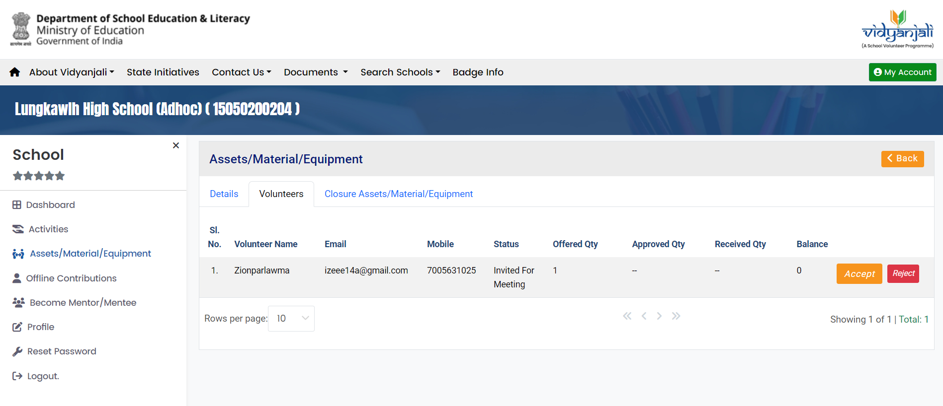
Step 6
Volunteer Name Email Mobile Status Offered Qty
Approved Qty Received Qty Balance
Accept
Reject
Accept

Slide 30
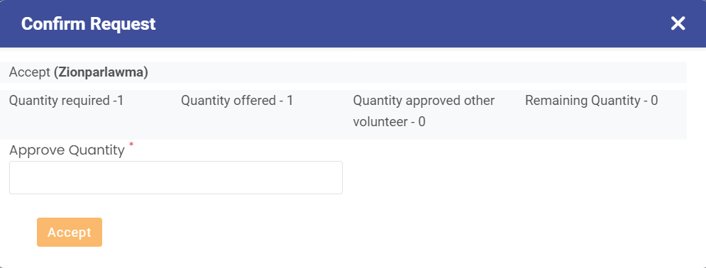
Step 7
Confirm Request
Accept (Volunteer Name)
Qty required 1 Qty offered 1 Qty approved 0 Remaining Qty 0
Approve Quantity
Accept

Slide 31
Step 8
Volunteer Name Email Mobile Status Offered Qty
Approved Qty Received Qty Balance
Add Delivery

Slide 32
Step 9
Delivery Request
Quantity Date of Receipt
Update

Slide 33
Step 10
Details Volunteer Closure Assets/Materials

Slide 34
Step 10
Contribution Participants
Close Contribution?
Volunteer Request(0) Volunteer Invited(0) Volunteer Confirmed(1) Volunteer Not Accepted(0)
Volunteer Request(0) Volunteer Invited(0) Volunteer Confirmed(1) Volunteer Not Accepted(0)
Sl.No Profile Image Name Mobile No. Quantity offered Action
No pending request found
Reason for Closure
Contribution Completed
Upload Upload Upload
Contribution Pic Contribution Pic Contribution Pic
1 2 3
Number of impacted
students
Closed
Note :You need to first
Upload all images to
close contribution□
Image types should be jpeg, png, jpg.
File size must be less than 200 KB

Slide 35
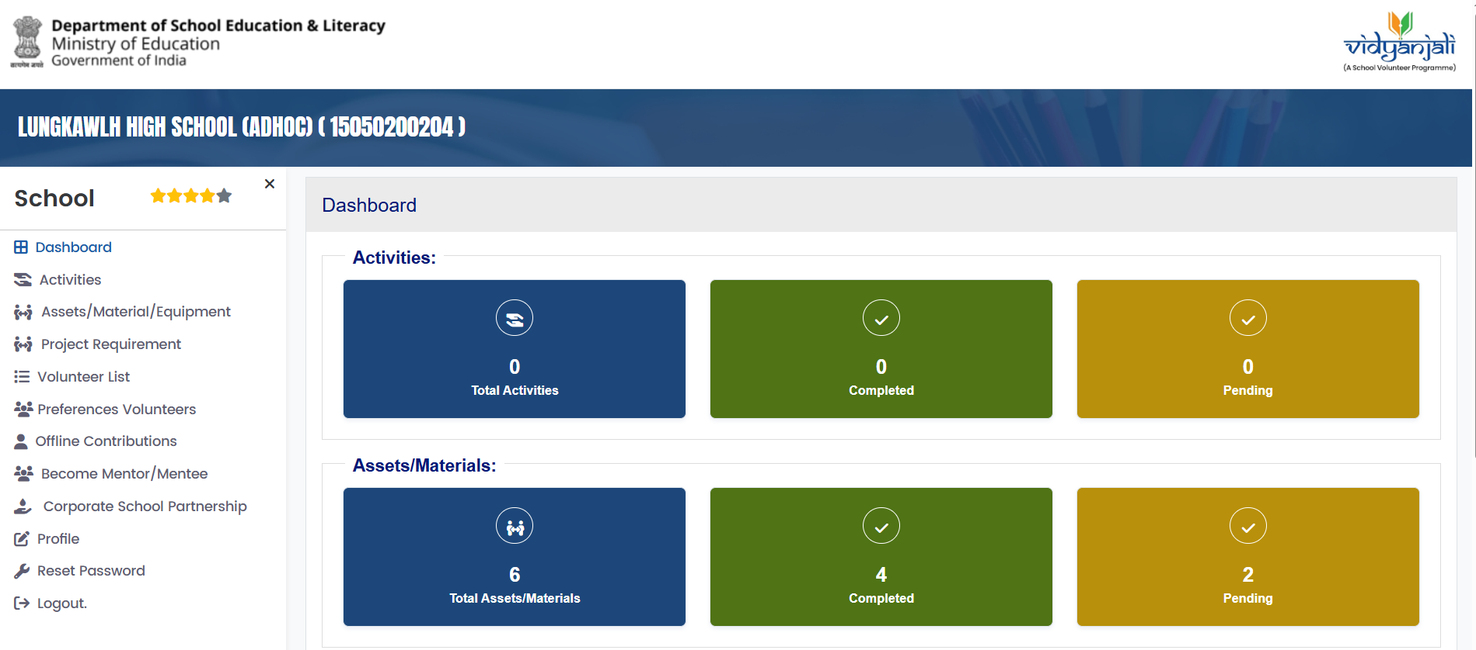
CORPORATE SOCIAL RESPONSIBILITY
After Login to School User
SCHOOL NAME & UDISE CODE
School
Activities
Assets/Materials
Project Requirement
Volunteer list
Preference Volunteers
Offline Contribution
Become Mentor/Mentee
Corporate School Parnership
Profile
Reset Password
Logout

Slide 36
CSR PROJECT STEP 2
SCHOOL NAME & UDISE CODE
School
+
Activities
Assets/Materials
Project Requirement
Volunteer list
Preference Volunteers
OFFLINE CONTRIBUTION
Become Mentor/Mentee
Corporate School Parnership
Profile
Reset Password
Logout
Draft Request Raised Ongoing Rejected Closed

Slide 37
CSR PROJECT STEP 3
Add Project Requirement(Assets/Materials)
Select Project Theme
Select
Basic Civil Infrastructure
Basic Electrical Infrastructure
Equipment for Co-Curricular Activities
Maintenance & Repairs
After selecting the theme the User need to fill the detail project information.
Then choose Save & Publish OR Save & Draft

Slide 38
CSR PROJECT STEP 4
SCHOOL NAME & UDISE CODE
School
+
Activities
Assets/Materials
Project Requirement
Volunteer list
Preference Volunteers
OFFLINE CONTRIBUTION
Become Mentor/Mentee
Corporate School Parnership
Profile
Reset Password
Logout
Draft Request Raised Ongoing Rejected Closed
Action
Select the Ongoing option to view the project. Click the Action button to proceed to the next screen.

Slide 39
CSR PROJECT STEP 5
After the school receives the quantities, the school user must check the button under the Action column, enter note in the receive note field, and then click the Update button.
Action
Udate

Slide 40
CSR PROJECT STEP 6
Draft Request Raised Ongoing Rejected Closed
Action
Close
View Project Details - Users can view the project details.
Download Certificate - School users can download the certificate. It is essential for users to upload this certificate at the time of project closure with Sign & Stamp of Head Master.
Close Project - User can close the project. They should upload the project images, acknowledgment, include remarks and the number of impacted students, and then submit the information.

Slide 41
CSR PROJECT STEP 7
Closed Project Requirement (Assets/Material
Remarks
Impacted Students
Close

Slide 42
TUTORIAL & PPT
samagra.mizoram.gov.in

Slide 43
Step 2
Intervention
Vidyanjali

Slide 44
Step 3
Vidyanjali
Vidyanjali.ppt
Vidyanjali Definition & Report.pdf

Slide 45
YOUTUBE CHANNEL
Youtube.com
vidyanjali2.0
Meaning & Registration
School accept volunteer
contribution
Volunteer Contribution
School Request

